Slide 1

Hostel Allotment System
Final Year Project Mid Presentation

Slide 2
Group members
17-SE-81
17-SE-105
17-SE-37

Slide 3
Introduction
Hostel Allotment system is a system use to allot rooms to students of colleges, universities and other educational institutes.
In this system rooms are allotted on base of GPA, session and number of students in a single room.
Educational institutes administration decide the policies for the room

Slide 4
Components
There are two main components or modules of this system.
1) Applicant side
Applicant has to register and then login to website (hostel allotment system) first in order to get room in a particular hostel.
2) Admin side
Admin / Employee has to register and then login to website first in order to define policies for the particular hostel.

Slide 5
Applicant side
Applicant has to register first for room allotment. He / she has to give his / her personal and other details i.e. Registration number, full name, phone number, email account, password and session (year in university).
After registration applicant has to login by putting email and password that he / she used during registration
A button is appear for room allot and by click on that he / she can get the room according to choice. But room is given only on base of GPA and session in institute.

Slide 6
Admin side
Admin has to register first for defining room policies. He / she has to give his / her personal and other details i.e. full name, phone number, email account, employee secret key and password.
After registration applicant has to login by putting email and password that he / she used during registration
A button is appear for defining room policies and by click on that he / she can get the define policies for room according to choice for the hostels. He has to tell minimum GPA and for session of applicant for range of rooms

Slide 7
Technologies and Tools
For this project we created dynamic website that handle the hostel allotment system.
We used fallowing tools, technologies and programming languages in final year project
HTML, CSS and Bootstrap
JavaScript with React.js
Node.js with express
MongoDB as database

Slide 8
a) HTML, CSS and Bootstrap
Hypertext Markup Language(HTML), a standardized system for tagging text files to achieve font, color, graphic, and hyperlink effects on World Wide Web pages. "an HTML file"
CSS stands for Cascading Style Sheets. CSS describes how HTML elements are to be displayed on screen, paper, or in other media CSS saves a lot of work. It can control the layout of multiple web pages all at once. External stylesheets are stored in CSS files.
Bootstrap is a free and open source front end development framework for the creation of websites and web apps. The Bootstrap framework is built on HTML, CSS, and JavaScript (JS) to facilitate the development of responsive, mobile-first sites and apps.

Slide 9
b) JavaScript with React.js
JavaScript is an object-oriented computer programming language commonly used to create interactive effects within web browsers.
React (also known as React.js or ReactJS) is a free and open-source front-end JavaScript library for building user interfaces or UI components.
It is maintained by Facebook and a community of individual developers and companies.
React can be used as a base in the development of single-page or mobile applications.
However, React is only concerned with state management and rendering that state to the DOM, so creating React applications usually requires the use of additional libraries for routing, as well as certain client-side functionality.

Slide 10
c) Node.js with Express
Node.js (Node) is an open source development platform for executing JavaScript code server-side. Node is useful...
Node.js is a platform built on Chrome's JavaScript runtime for easily building fast and scalable network applications. Node.js uses an event-driven, non-blocking I/O model that makes
Express is a back end web application framework for Node. Express released as free and open-source software under the MIT License.
It is designed for building web applications and APIs. It has been called the de facto standard server framework for Node.

Slide 11
d) MongoDB as database
MongoDB is a document database with the scalability and flexibility that you want with the querying and indexing that you need.
MongoDB is a source-available cross-platform document-oriented database program.
Classified as a NoSQL database program, MongoDB uses JSON-like documents with optional schemas. MongoDB is developed by MongoDB Inc. and licensed under the Server Side Public License (SSPL).

Slide 12
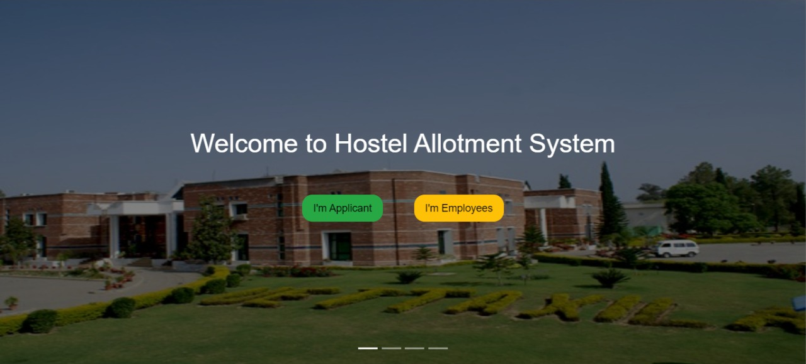
Results and Output
Home page

Slide 13
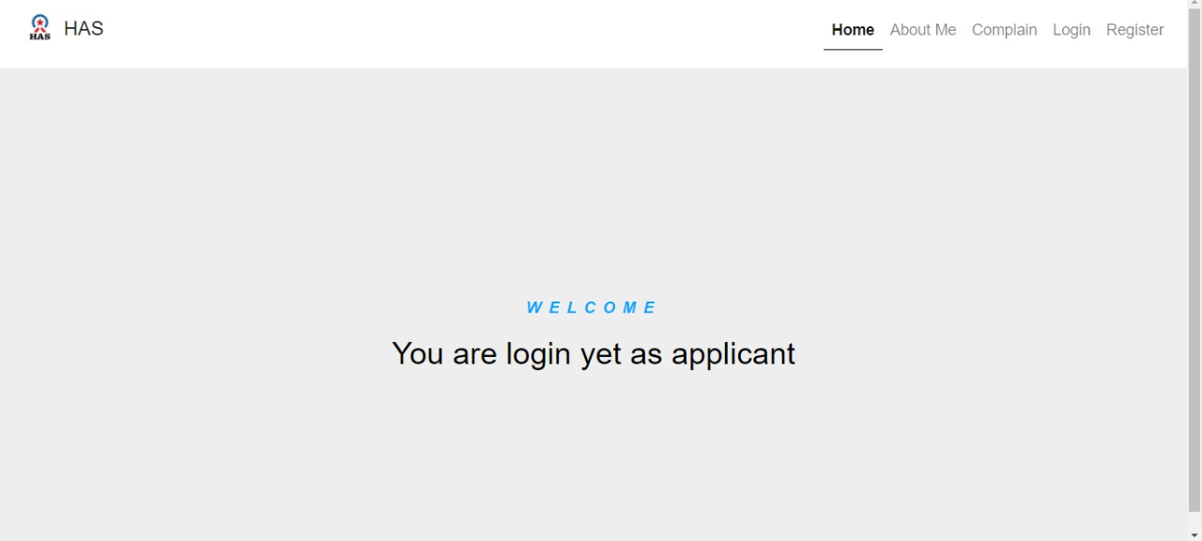
Results and Output
Dashboard page

Slide 14
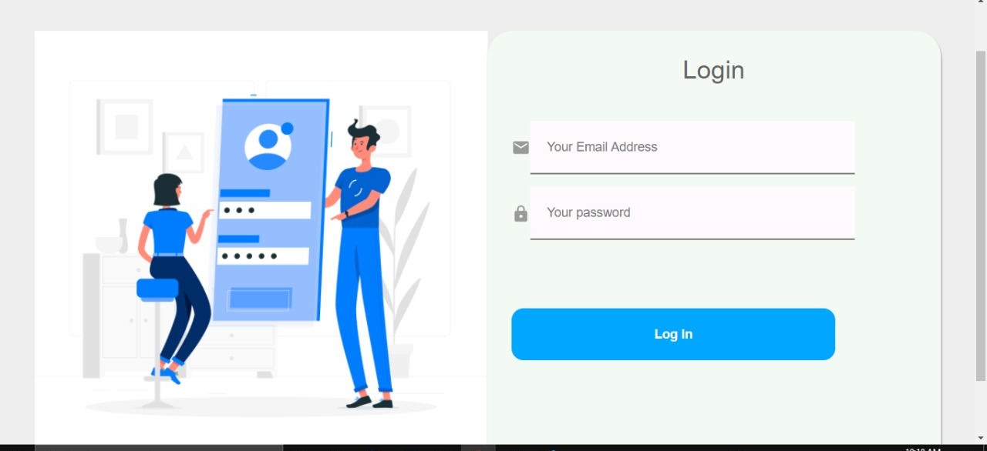
Results and Output
Login page

Slide 15
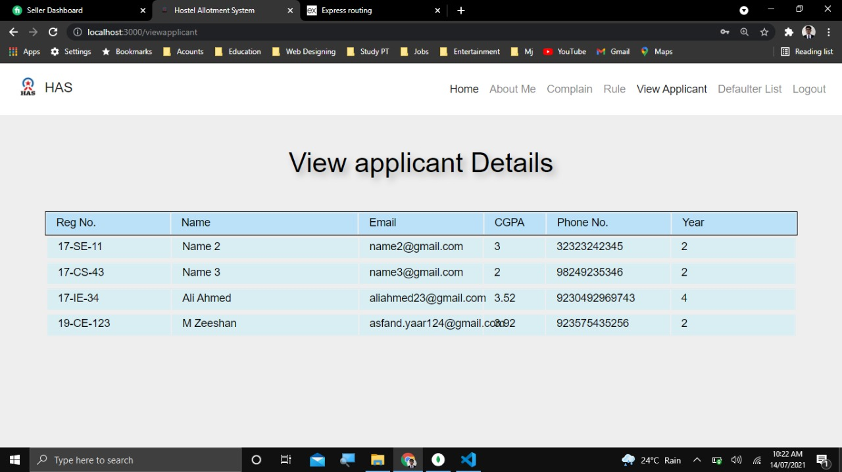
Results and Output
Applicant page

Slide 16
Conclusion
Hostel allotment system is a very useful web-based application this reduces the effort of the hostel managers to manage and keep the record easily and safely. This web-based application has a user-friendly interface with a rich GUI for easy to understand, easy to use. We will add more functionalities and make it more efficient and responsive to expand it to other universities and other private hostels in the future.

Slide 17
References
[1] E. A. B, "HOSTEL MANAGEMENT SYSTEM," June 2015. [Online]. Available: https://www.academia.edu/37040228/HOSTEL_MANAGEMENT_SYSTEM_full_project_1_.
[2] J. Walke, "React (JavaScript library)," 22 march 2021. [Online]. Available: http://en.wikipedia.org/wiki/React_(JavaScript_library).
[3] IIUI, 2021. [Online]. Available: http://usis.iiu.edu.pk:64453/
[4] 2017. [Online]. Available: https://www.cityhostels.com.pk/about/.
[5] R. Dahl, "Node.js," 23 June 2021. [Online]. Available: https://en.wikipedia.org/wiki/Node.js

Slide 18


